Slide 1
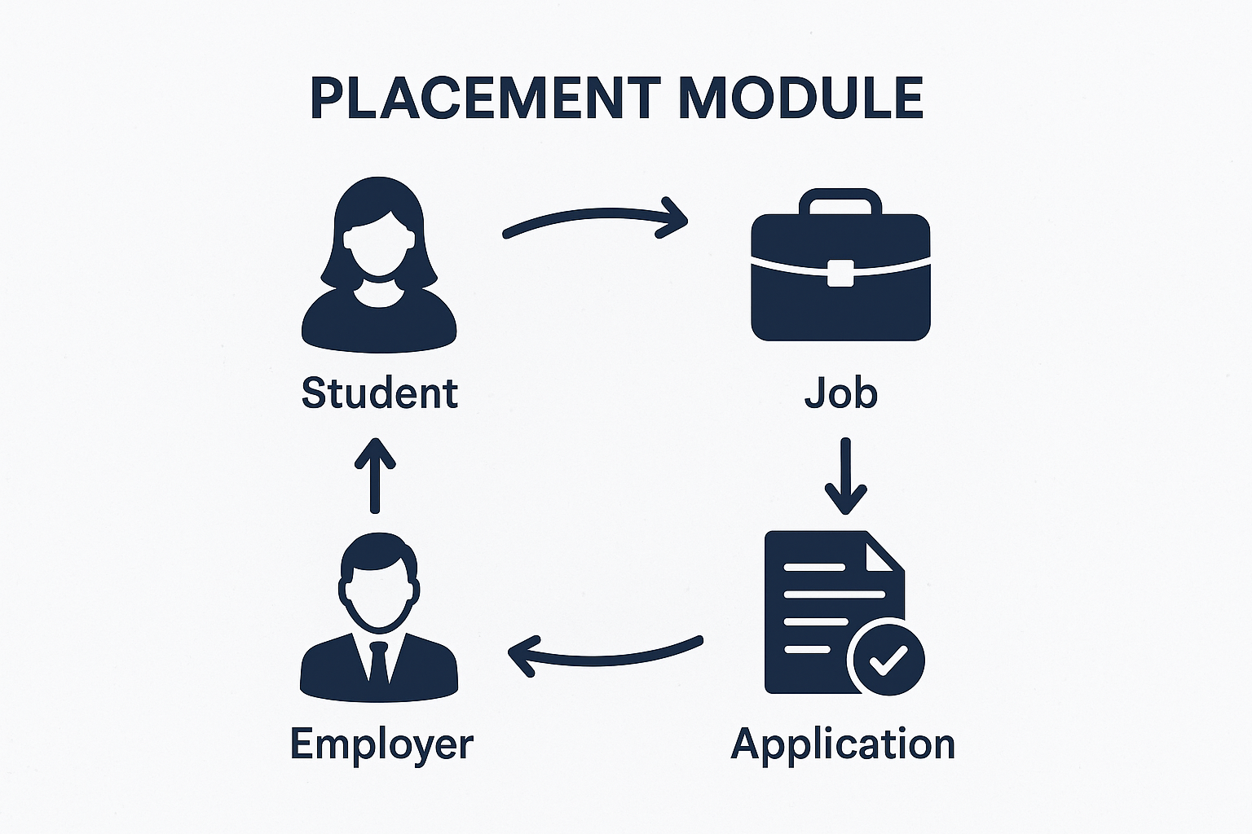
Placement Module
The impact of placement opportunities varies based on access, skill alignment, and institutional support. With increasing competition and limited industry engagement, students and institutions face heightened challenges in securing placements, directly affecting career outcomes and long-term employability. Addressing gaps in placement success, especially in underrepresented or resource-limited institutions, requires efficient placement strategies—achievable only through accessible and well-managed placement data.
Submitted by:
1.Ujjwal Soni (2100290120179)
2.Akash Pandey (2200290129003)
3.Aditya Narayan Yadav (2200290129002)
4.Praveen Kumar Yadav (2200290129014)

Slide 2
Project Abstract
Overview
Key Objectives
Approach
The placement management system automates student record handling, tracks placement events, facilitates feedback sharing on interviews, and provides recent interview questions to improve student preparation, ensuring efficient and organized placement processes.
1. Reduce manual work by managing student records and placement details.
2. Track placement training and events within and outside the college.
3. Enable feedback sharing on interviews to assist future applicants.
4. Provide latest interview questions to improve student preparation.
Centralized database to manage student records and placement details.
Online forms for automated student data collection and updates.
Feedback module for sharing interview experiences with future applicants.

Slide 3

Project Goals and Objectives
Streamline Placement Processes
1
.
2
Enhance Student Preparation
Ensure Data Accuracy:
3
.

Slide 4
Alignment with UN Sustainable Development Goals (SDGs)
SDG 4: Quality Education
Platform Role: To reinforce its value, the system offers students necessary accessories such as recent interview questions, skills-based preparation material, and previous candidate feedback. It also contributes to career advancement, skill acquisition and training, and learning throughout life making them ready to work to graduate.

Slide 5
2. SDG 8: Decent Work and Economic Growth
Platform Role: The platform lowers youth employment , Improves economic growth and encourage fair and equal access to employment by matching student with variety of career opportunities. It guarantees effective job-matching procedures and promotes more seamless transitions from college to respective employment.
3. SDG 10 :Reduced Inequalities
Platform Role: They have high standards for opportunities to work for students as compared to students for the placement of resources, tools, and job opportunities students have equal rights irrespective of any class, caste or color. This has the effect of mitigating the disparity in the get of jobs and makes the placement of learners a fair place.

Slide 6




Methodology and Approach
Define Objectives and Scope:
Clear goals, constraints, desired outcomes.
Analysis and Interpretation
Identify patterns, insights, key issues.
Evaluation and Reporting
Measure impact, prepare final report.

Slide 7




Expected Outcomes and Impact
Enhanced Student
Experience
Better Coordination
Increased Preparedness

Slide 8

Key Project Deliverables
Probability of Selection Feature
Resource Sharing Platform
Recruitment Stage Tracking
AI-Powered Personalized Recommendations
Organized Content Library
Virtual Mock Interviews

Slide 9

Next Steps and Conclusion
1
Public Awareness Campaign
Launch targeted campaigns to inform students, institutions, and employers about the features and benefits of the placement module to drive adoption and engagement.
2
Deployment and Testing
Implement the placement module in pilot institutions, monitor usage, gather user feedback, and troubleshoot issues to optimize performance.
3
Scaling and Updates
Roll out the placement module to a broader user base, continuously update functionalities based on feedback, and ensure ongoing support and training.

